Slide 1

Advanced Graphing in R:
ggplot2 package
MTH 243 Crash Course
By : Mahmoud Kharoof & Ananya Sudheer

Slide 2
Learning Objectives:
Brief Introduction to ggplot2.
Graph enhancement in ggplot2.
qplot()
ggplot()
Advantages of knowing the advanced graphing tools in ggplot2.

Slide 3
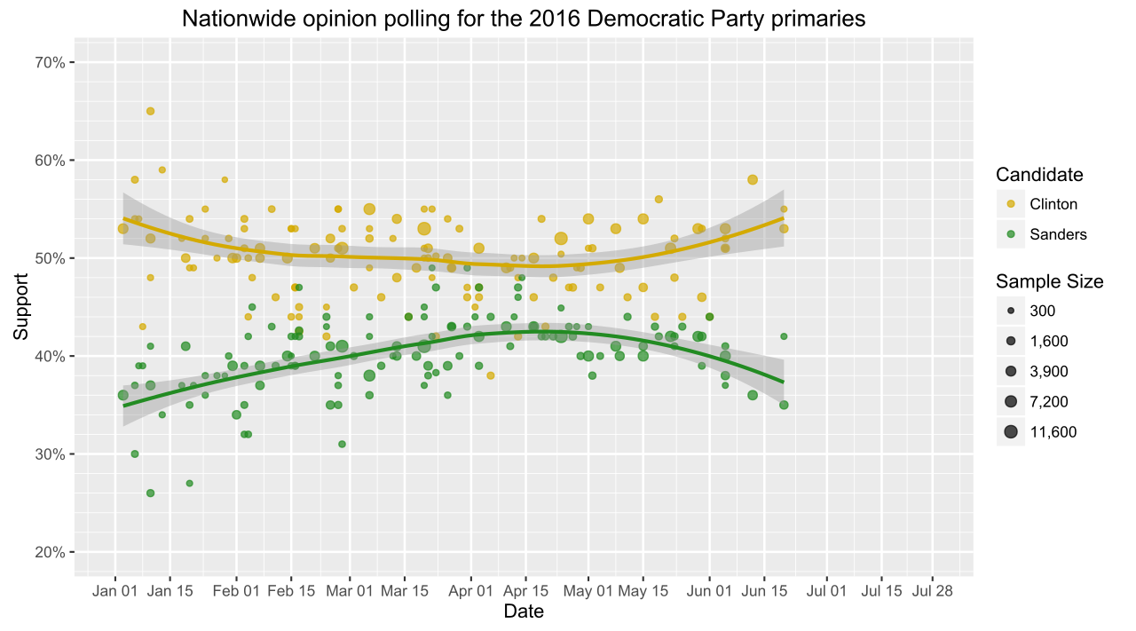
Different types of advanced graphing tools in ggplot2.
Code representation of the advanced graphing tools in ggplot2.

Slide 4
Brief Introduction to ggplot2
The ggplot2 package provides a method of creating innovative graphs based on a comprehensive graphical “grammar.”
For the advanced part it works as a multi layer system.

Slide 5
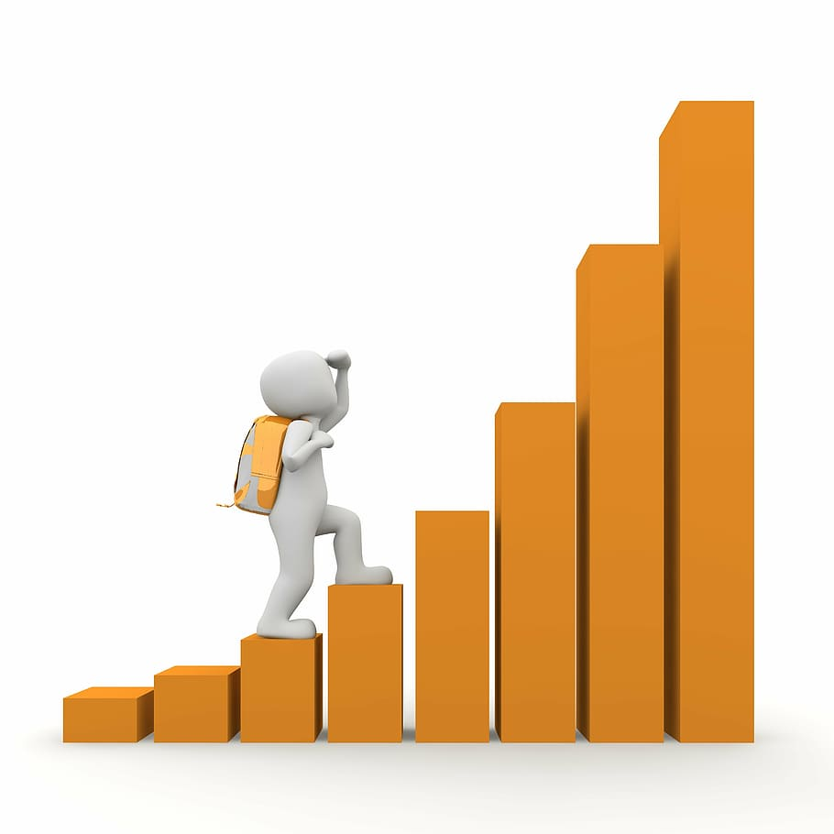
A plot in ggplot2 is made up of multiple layers. A layer consists of data, a set of mappings between variables and aesthetics, a geometric object and a statistical transformation. Scales control the details of the mapping.
All components are independent and reusable.
The ggplot2 package was created to make building plots in R easier. It uses the science of aesthetics to easily make plots that are much more aesthetically pleasing to the eye.

Slide 6
Advantages of knowing the advanced graphing tools in ggplot2
ggplot2 provides helpful commands to create complex plots from data in a data frame.
It provides a more programmatic interface for specifying what variables to plot, how they are displayed, and general visual properties. Therefore, we only need minimal changes if the underlying data change or if we decide to change from a bar plot to a scatterplot.
This helps in creating publication quality plots with minimal amounts of adjustments and tweaking.

Slide 7
Graph enhancement in ggplot2
Two options of working with the ggplot2 package:
Easy – using qplot() (=quick plot)
Complicated – using ggplot

Slide 8
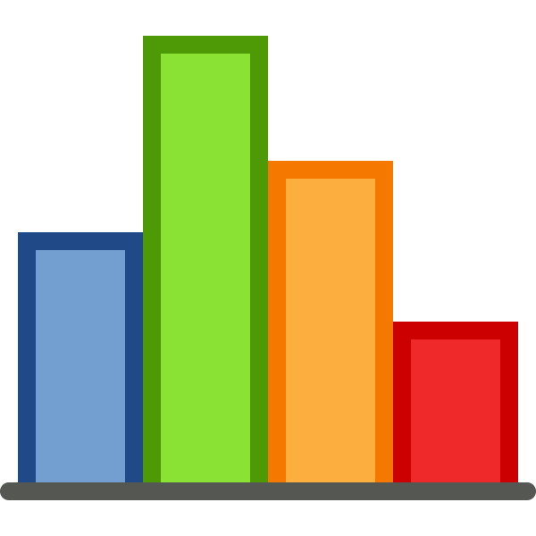
qplot()
Basically very similar to the function plot() in R.
The first two arguments to qplot() are x and y.
An optional data argument (recommended).
Does not provide as many features to edit and enhance the graph as ggplot().

Slide 9

ggplot2()
ggplot2 works by creating the plot layer by layer
A layer is composed of four parts:
data and aesthetic mapping
a statistical transformation (stat)
a geometric object (geom)
and a position adjustment.

Slide 10
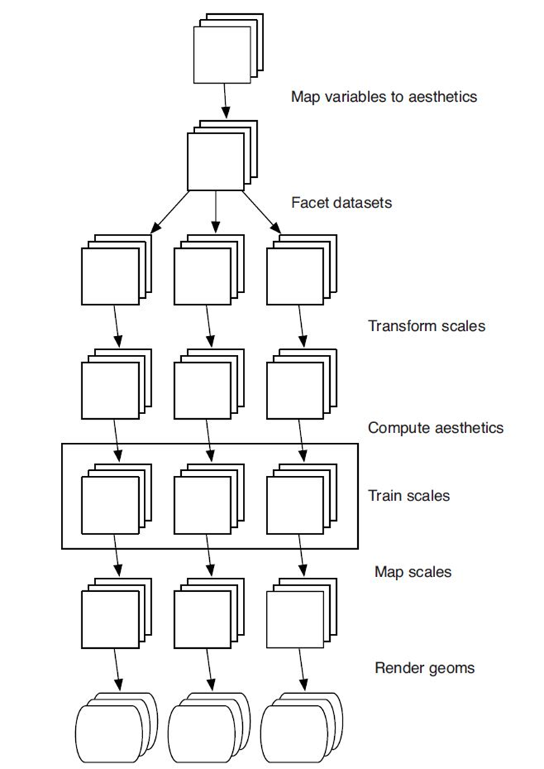

Slide 11
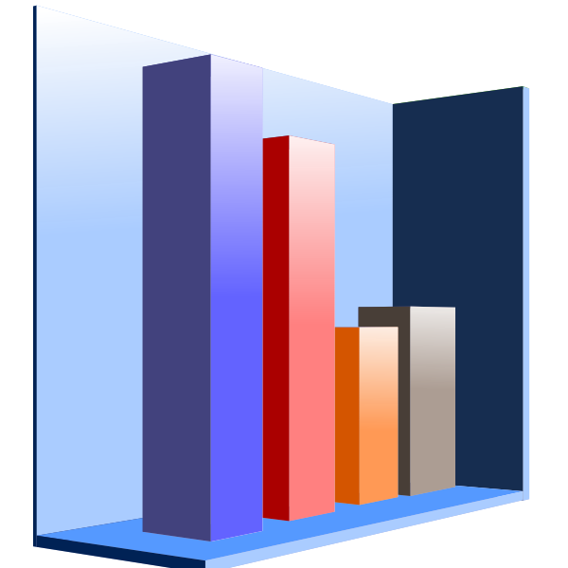
ggplot2() continued…
Quick Guide Essential layers are needed to make the graph
Data frame.
aesthetics: x, y, and z variables.
geometrics: Type of graph (scatter, line, bar, etc.)

Slide 12
Optional layers add flare and visual/statistical enhancements
Facets: Place multiple plots on a single canvas
Statistics: Add stat function, lines, and variance shades
Coordinates: Adjust or flip the x-y axis or x-y ratios to stretch or smooth out a plot
Scale: Change colors or shapes
Labels: Titles and labels
Theme: Add professional and unique looks

Slide 13
Different Types of Advanced Graphing Tools In ggplot2 (DTAGTIggplot2)
To use the full power and potential of grammar graphics we need to fully understand the functions or the features provided by the ggplot2 package, and what are the fundamental parts of every data graph, To be fully capable of developing advanced graphs in R using ggplot2.

Slide 14
Data Used In following slides
workshop gender q1 q2 q3 q4 pretest posttest
1 R Female 4 3 4 5 72 80
2 SPSS Male 3 4 3 4 70 75
3 NA NA 3 2 NA 3 74 78
4 SPSS Female 5 4 5 3 80 82
5 Stata Female 4 4 3 4 75 81
6 SPSS Female 5 4 3 5 72 77

Slide 15
Aesthetics (DTAGTIggplot2 contd.)
Aesthetics are the roles that the variables play in each graph. A variable may control where points appear, the color or shape of a point, the height of a bar and so on.
Sample code: ggplot(mydata100) + geom_bar( aes(workshop) )

Slide 16
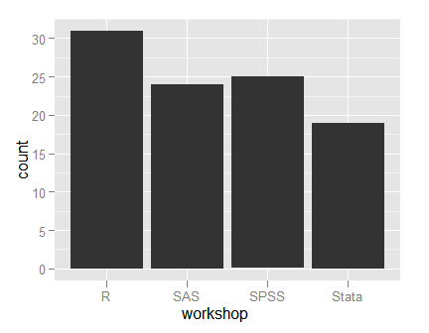
Output:

Slide 17
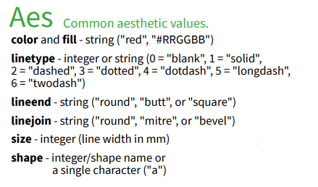

Slide 18
Geoms (DTAGTIggplot2 contd.)
Geoms are the geometric objects. Do you need bars, points, lines?
Sample code: ggplot(mydata100, aes(posttest) ) +geom_histogram(color="white") #color of the bar edges set to white

Slide 19
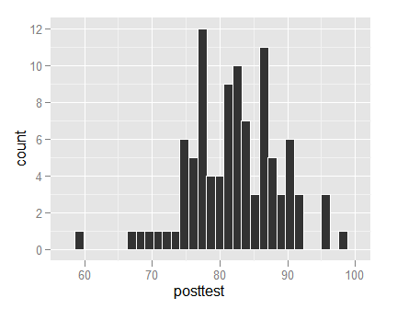
Output:

Slide 20
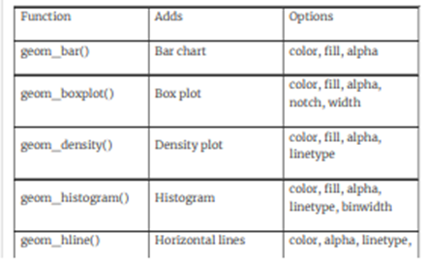

Slide 21
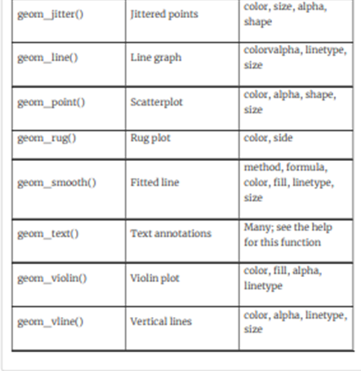

Slide 22
Scales (DTAGTIggplot2 contd.)
Scales are legends that show things like circular symbols represent females while triangles represent males.
Sample code: ggplot(mydata100, aes(pretest, posttest) ) + geom_point( aes(shape=gender ) )

Slide 23
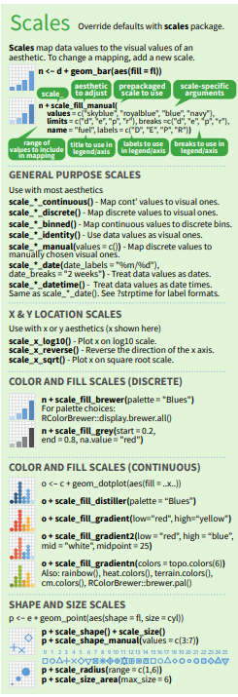

Slide 24
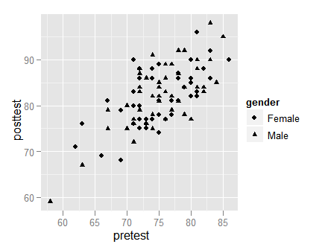
Output:

Slide 25
Facets (DTAGTIggplot2 cont'd.)
Facets – these are the groups in your data. Faceting by gender would cause the graph to repeat for the two genders.
Sample code: ggplot(mydata100, aes(workshop) ) + geom_bar() + facet_grid(gender ~ .)

Slide 26
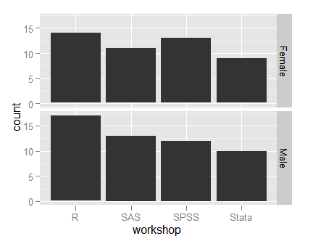
Output:

Slide 27
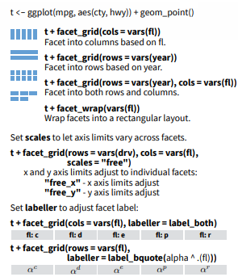

Slide 28
So , let’s start!
For this tutorial, we will use the Employee dataset. This data offers (fictitious) business insight and requires no preprocessing. Sweet!
Let’s install libraries and import the data.

Slide 29
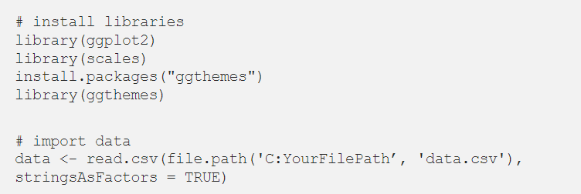

Slide 30
Step 1. Data, Aesthetics, Geoms
For this problem, ‘JobRole’ is our X variable (discrete) and ‘MonthlyIncome’ is our Y variable (continuous). ‘Attrition’ (yes/no) is our z variable. We will use geom_bar(). This would give us total monthly income of all employees. We instead want average, so we insert (stat = ‘summary’, fun = mean)

Slide 31
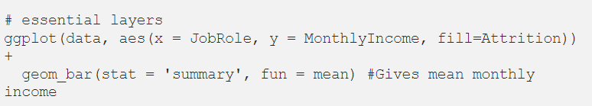

Slide 32
Step 2. Coordinates and Position Adjustments
When names are too long, it often helps to flip the x and y axis. To do so, we will add coord_flip() as a layer, as shown below. We will also unstack the bars to better compare Attrition, by adding position = ‘dodge’ within geom_bar() in the code.

Slide 33
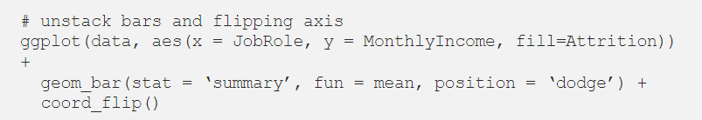
Run the code upto this part!!!

Slide 34
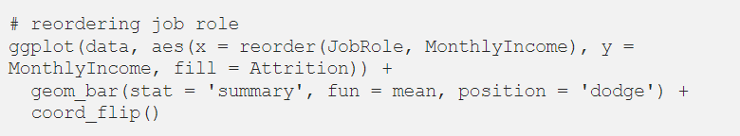
Step 3. Reorder bars from highest to lowest
Now, let’s reorder the bars from highest to lowest Monthly Income to help us better analyze by Job Role.

Slide 35
Step 4. Change bar colors and width
To list colors in R: scale_fill_manual()
Also, we will narrow the bar widths by adding ‘width=.8’ within geom_bar() to add visually-appealing space.

Slide 36
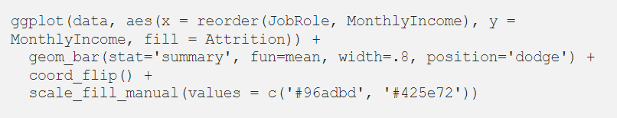
Run the code until here!

Slide 37
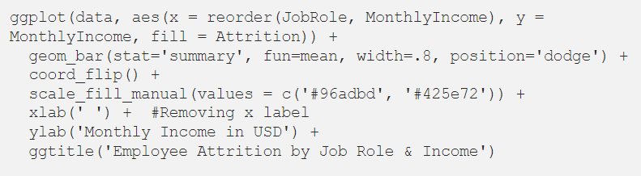
Step 5. Title and Axis Labels
Now let’s add Title and Labels.

Slide 38

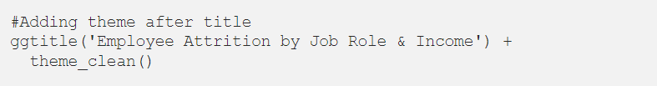
Step 6. Add Theme
We will add a theme layer at the end of our code, as shown below. When you start typing ‘theme’ in R, it shows options. For this graph, I chose theme_clean()

Slide 39


